Slide 1


Employee Data Analysis using Excel
STUDENT NAME: Jeevanandham K
REGISTER NO: 22CM311
DEPARTMENT: B.COM(GENERAL)
COLLEGE: DRBCCC HINDU COLLEGE

Slide 2
PROJECT TITLE
Employee Performance Analysis using Excel

Slide 3
AGENDA
Problem Statement
Project Overview
End Users
Our Solution and Proposition
Dataset Description
Modelling Approach
Results and Discussion
Conclusion

Slide 4
PROBLEM STATEMENT
Background: Our company has a diverse workforce distributed across various departments. To effectively manage and enhance employee performance, the HR department requires a structured approach to performance evaluation.
Objective: To develop an Excel-based system that will
Evaluate Employee Performance
Track Progress Over Time
Support HR Decisions

Slide 5
PROJECT OVERVIEW
Data Collection: Employee details, performance metrics, evaluation scores, attendance, and training records
Data Organization: Raw data, performance metrics, employee summaries, and departmental overviews.
Analysis Tools: Formulas, PivotTables, charts/graphs, conditional formatting, and data validation
Reporting: Detailed performance reports, visual dashboards, and actionable insights

Slide 6
WHO ARE THE END USERS?
Human Resources (HR) Managers
2. Department Heads/Managers
3. Line Managers/Supervisors
4. Employees
5. Senior Leadership/Executives
6. Training and Development Specialists

Slide 7
OUR SOLUTION AND ITS VALUE PROPOSITION
Data Integration: Centralized collection of employee performance metrics, evaluation scores, and additional data.
Advanced Analysis: Utilization of formulas, PivotTables, and charts to provide deep insights into individual and departmental performance.
Dynamic Reporting: Comprehensive reports and visual dashboards that summarize key performance metrics and trends.
User-Friendly Interface: Easy-to-navigate Excel workbook with data validation and conditional formatting to enhance usability.

Slide 8
Dataset Description
EMPLYEEE = KAGGLE
26 – FEATURES
9 – FEATURES
EMPLOYEE ID-NUM
NAME-TEXT
EMPLYEE TYPE
PEFORMANCE LEVEL-TEXT
GENDER- MALE,FEMALE
EMPLOYEE RATING-NUM

Slide 9
THE "WOW" IN OUR SOLUTION
PERFORMANCE LEVEL=IFS(Y2>=5,"VERY HIGH",Y2>=4,"HIGH",Y2>=3,"MID",TRUE,"LOW")

Slide 10
MODELLING
DATA COLLECTION
THE DATA HAS BEEN COLLECTED FROM KAGGLE
SEPREATED THE WANTED DATA FROM COLLECTED DATA’S
FEATURES COLLECTION
IDENTIFIED THE FEATURES
26- FEATURES 9- HAS BEEN USED
DATA CLEANING
IDENTIFIED THE MISSING VALUES
FITERED THE MISSING VALUES
PERFOMANCE LEVEL
TO VERIOUS THE PERFORMANCE LEVEL OF EMPLOYEEE CONSIDERED THE RATING CALUM EXTRACTD INTO TEXT
AND USED THE FORMULA =IFS(Y2>=5,"VERY HIGH",Y2>=4,"HIGH",Y2>=3,"MID",TRUE,"LOW")

Slide 11
MODELLING
VISUALIZATION OF DATA
PIE CHARTED THE DATA PROGROSSES
BY USING THE PIVOT TABLE
PRESENTATON
USED THE DATA AND CHARTS TO CLEAR VISION OF PROGROSS
BREING THEM ALL AND COMBINE FOR PPT

Slide 12
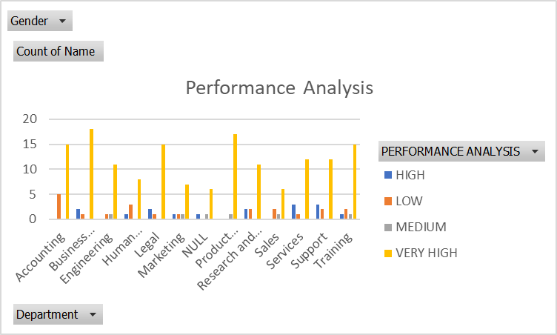
RESULTS

Slide 13
conclusion
Summary: The Excel-based Employee Performance Analysis system provides a robust framework for evaluating and improving employee performance. By leveraging structured data, advanced analysis tools, and visual reporting, the system enhances decision-making, transparency, and efficiency in HR processes.
Benefits :
Informed Decision-Making
Enhanced Performance Tracking
Efficient Reporting
User-Friendly Interface

